Slide 1
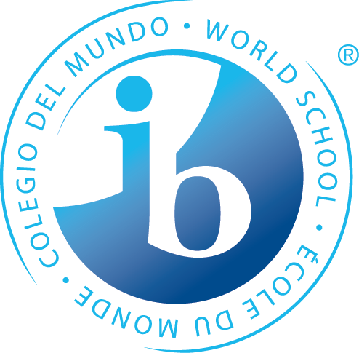
The International Baccalaureate Primary Years Programme at Antietam Elementary School
Family Information Session
January 20, 2022
Via Zoom Breakout Room

Slide 2
Antietam’s Feeder Schools
Your child(ren) would transfer to Antietam for the IB program if they attend one of the following elementary schools:
Belmont Potomac View
Covington-Harper River Oaks
Featherstone Rockledge
Fitzgerald Springwoods
Kilby Swans Creek
Lake Ridge Triangle
Leesylvania Vaughn
Marumsco Hills Westridge
Occoquan Williams
Old Bridge
Students who attend Antietam as their base (neighborhood) school are automatically part of the IB program.
If your child(ren) attend a school not listed above, they would transfer to one of the other PYP schools: Ellis, Mullen, Rosa Parks, or Buckland Mills. You need to leave this breakout session and return to the general meeting.

Slide 3
Antietam as a PWCS School
Antietam Elementary opened in 1990. It has gone through some renovations and expansions in the past few years.
As of September 2020, we had 777 students and 87 staff members.
In the past 20 years, we have been a School of Excellence for 16 of those years, including 2018-2019 and 2019-2020.

Slide 4
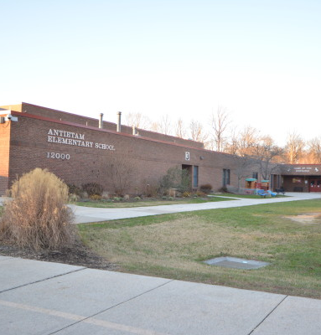
Antietam as an IB School
Antietam Elementary became an IB candidate school in 2013. We were authorized as an IB School in April 2017. We have been undergoing an evaluation this past year, concluding with a remote visit November 15-17!

Slide 5
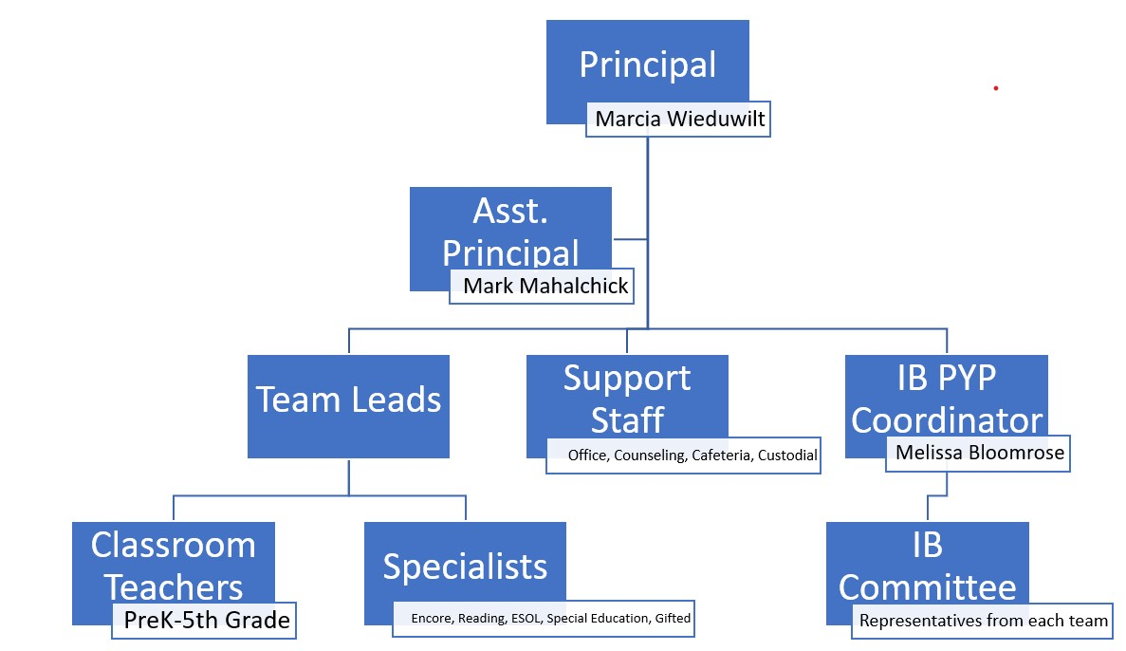
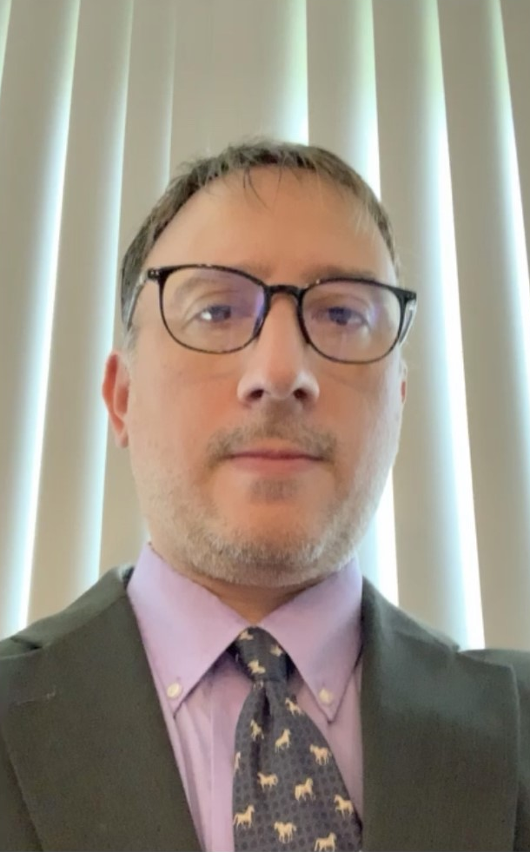
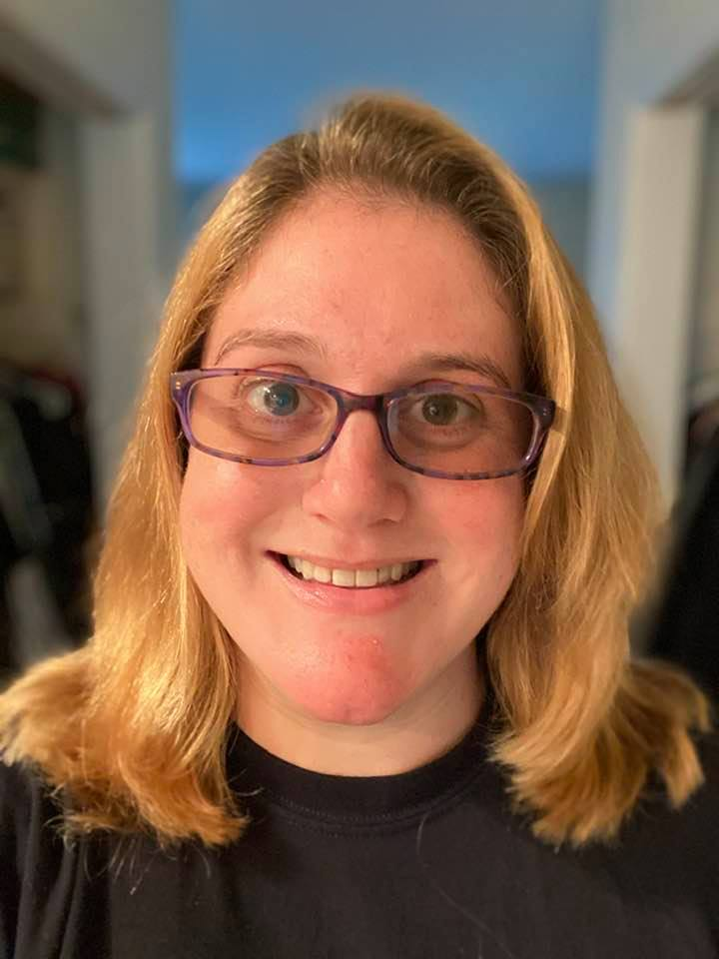
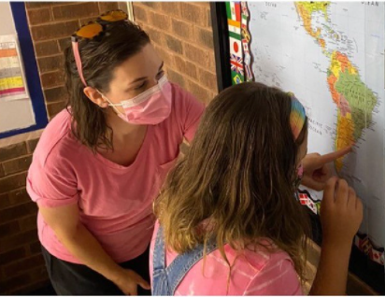
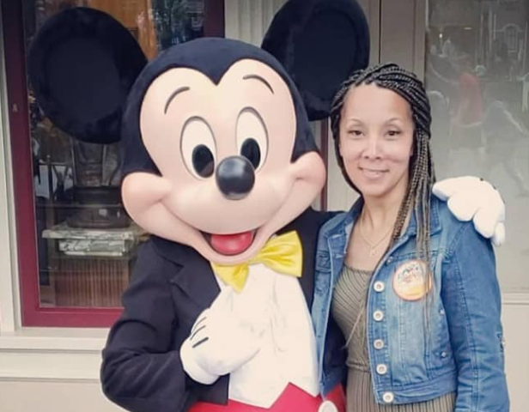
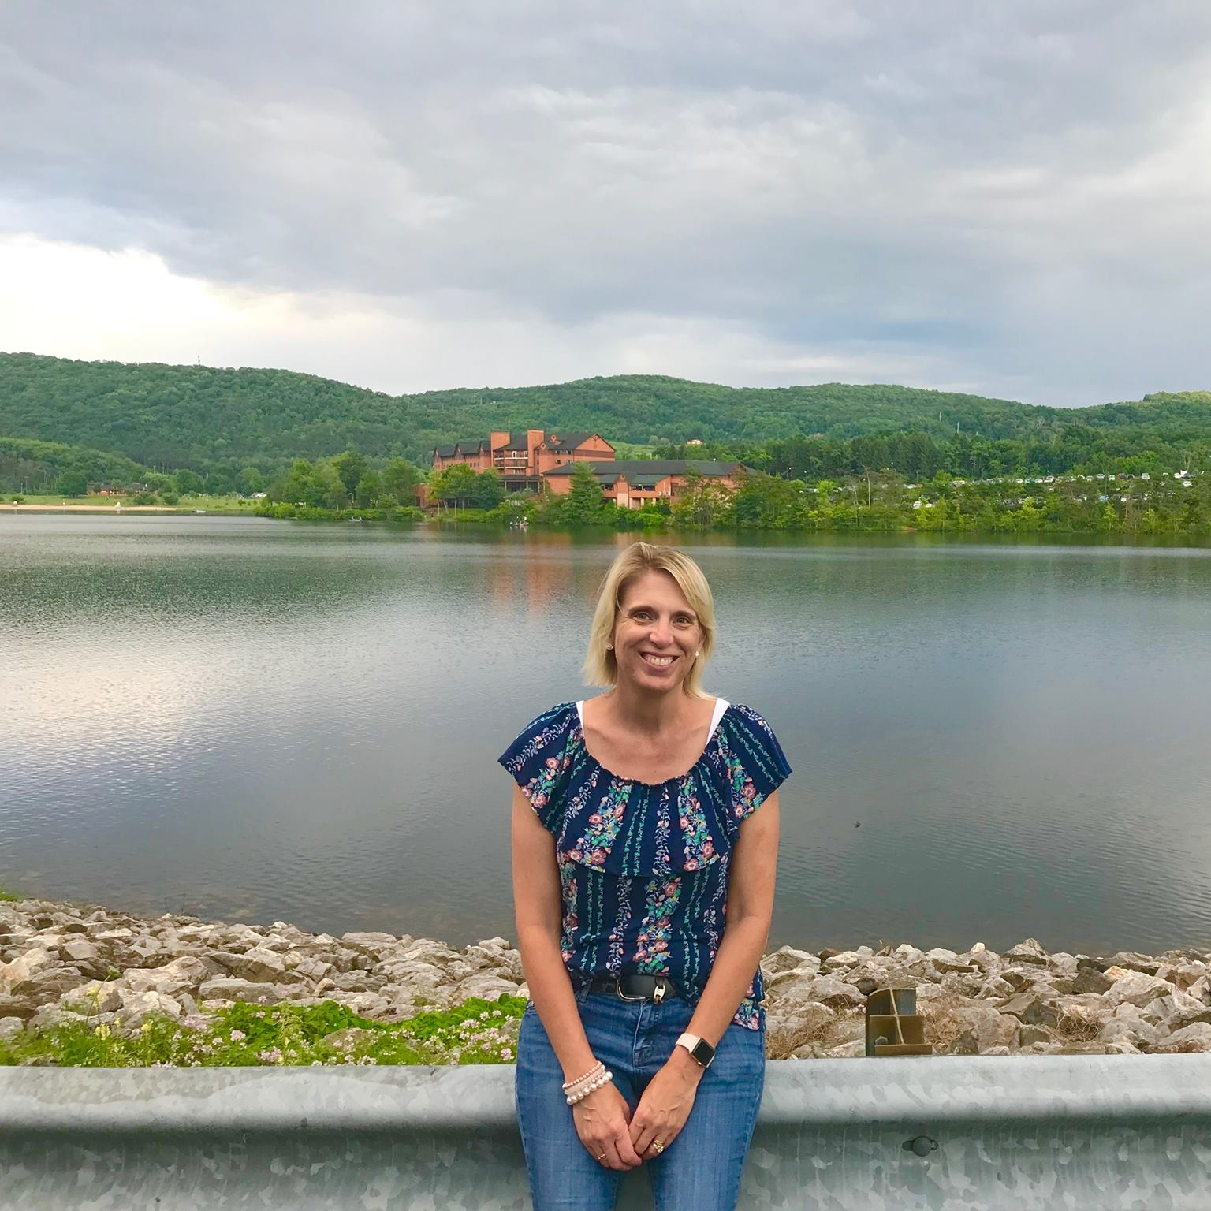
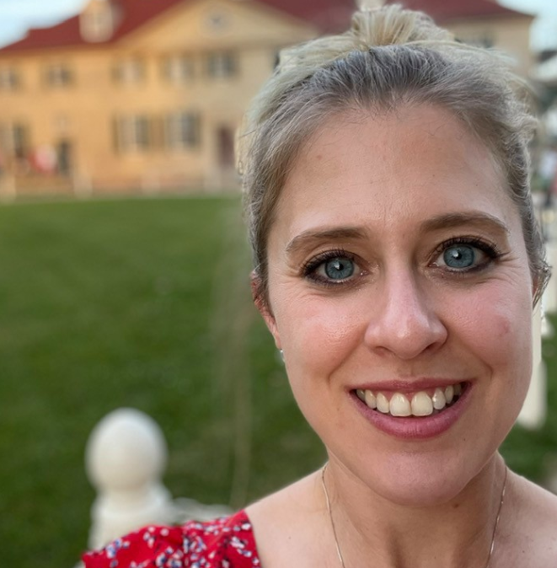
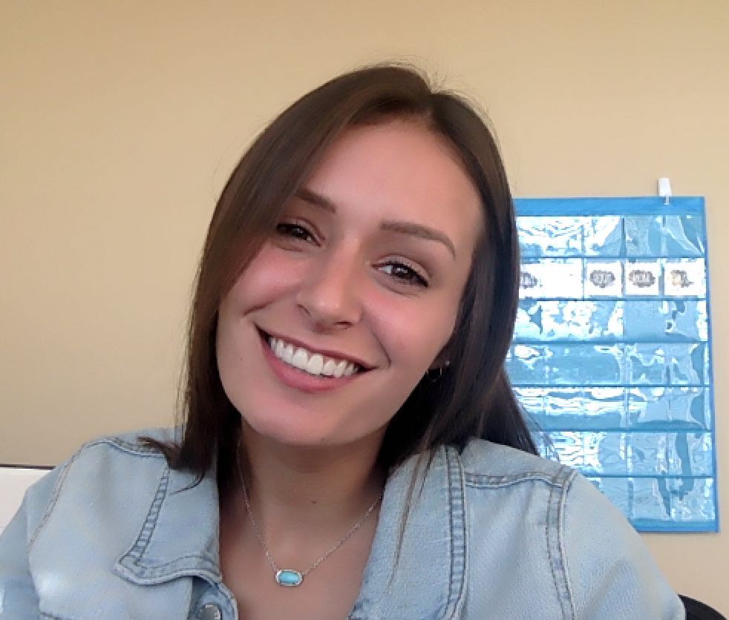
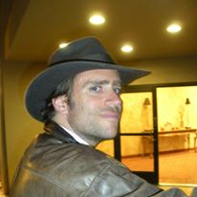
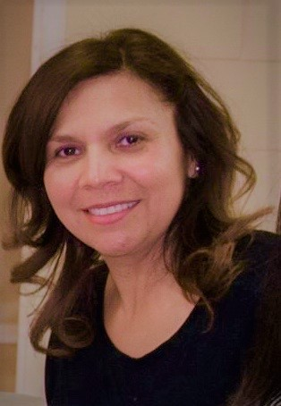
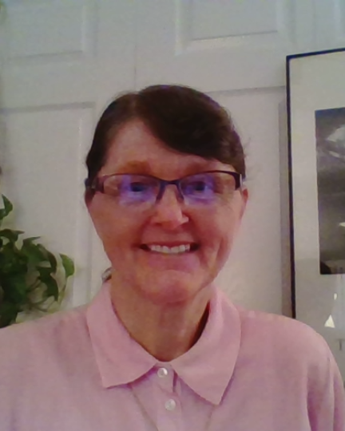
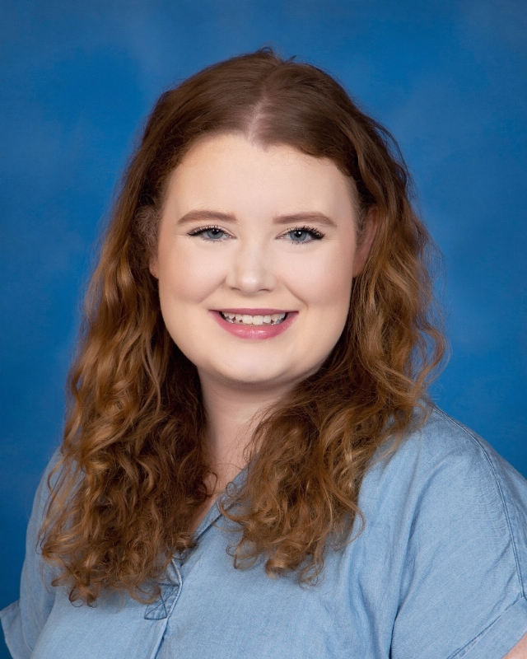
Who’s Who

Slide 6
What Does IB PYP Look Like at Antietam?

Slide 7
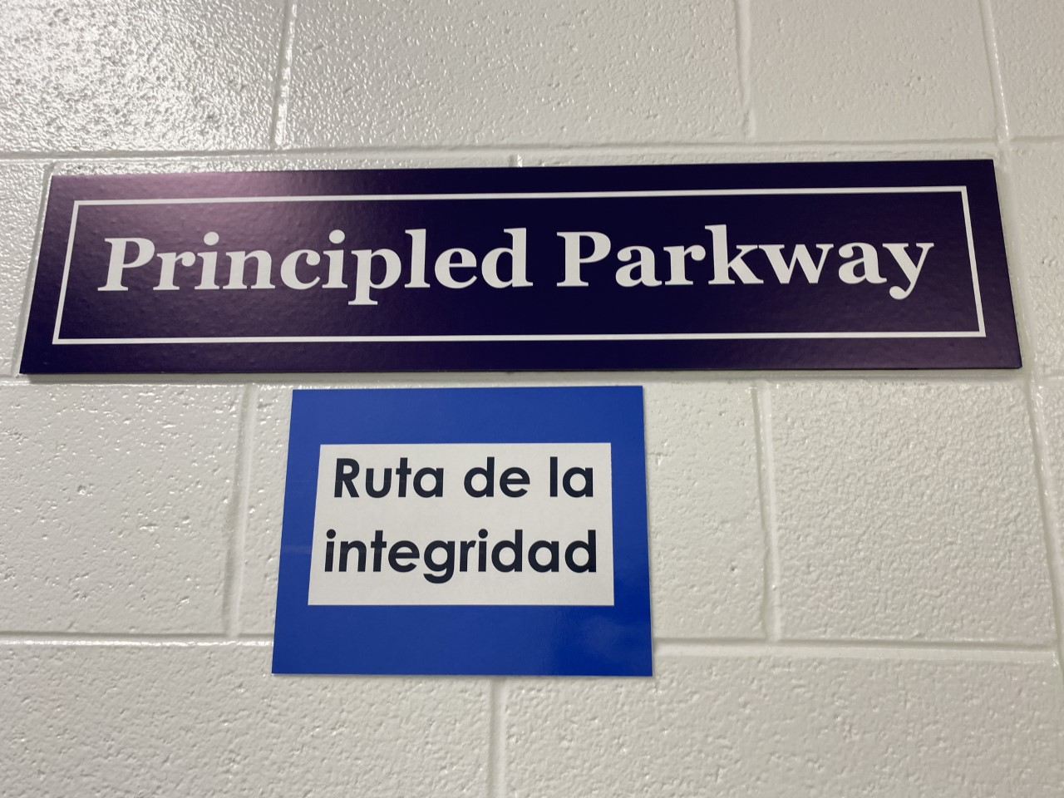
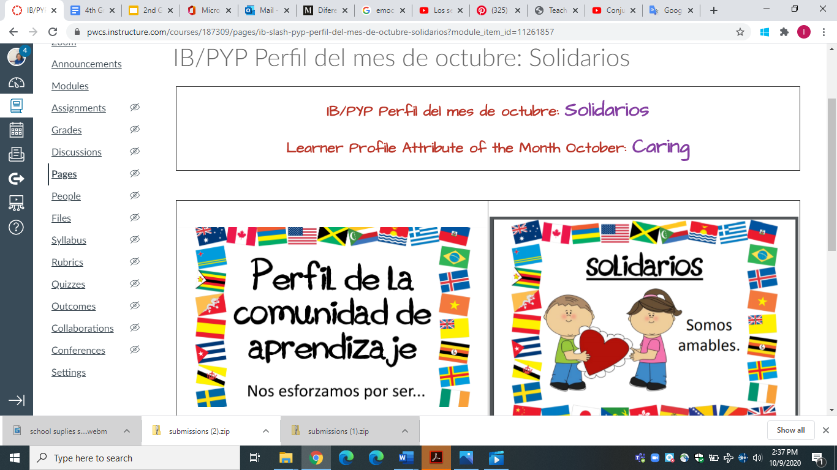
World Language: Spanish
An important component of International Baccalaureate is students learning a second language. In the Primary Years Programme, it is an introduction to the language, more about exposure and basic vocabulary.
Currently at Antietam, students have Spanish class every 5 days, for 45 minutes, as part of the Encore (specials) rotation. Students do not receive a grade for Spanish.
You can see Spanish throughout our building, such as labels for classroom items and street signs in our hallways.

Slide 8
Antietam Elementary is fortunate to have a subscription to Seesaw, paid for by our PTA.
In Seesaw, teachers can post assignments, students can submit those assignments, and parents have immediate access. Teachers and parents can provide feedback.
Each student has a portfolio in Seesaw, in which they choose 2-3 assignments per IB unit to highlight. They reflect on their learning. This portfolio continues with them through their school career at Antietam.

Slide 10
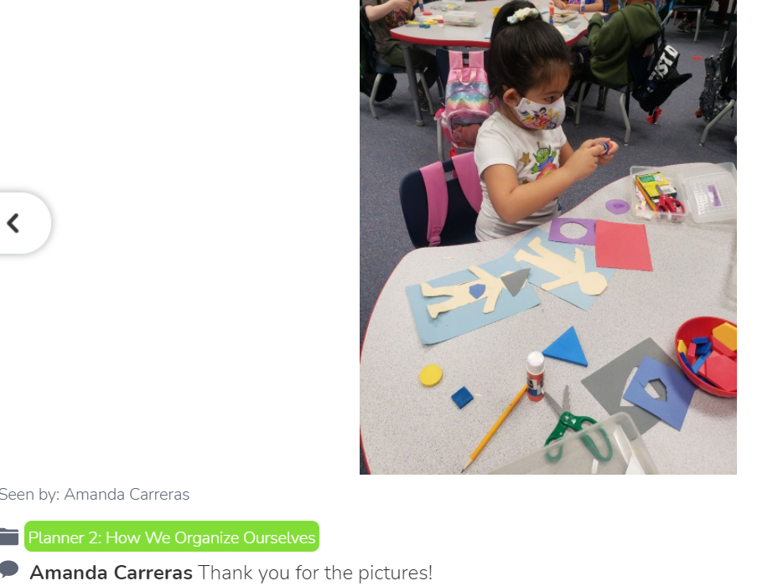

Slide 11
Transfer Application
During this current 2021-2022 school year, we have 35 transfer students for the IB program!
We would love to add more transfer students to our Antietam school community!
Transfer Application:
https://www.pwcs.edu/academics___programs/advanced_academics___specialty_programs/specialty_programs
Due February 1, 2022

Slide 12
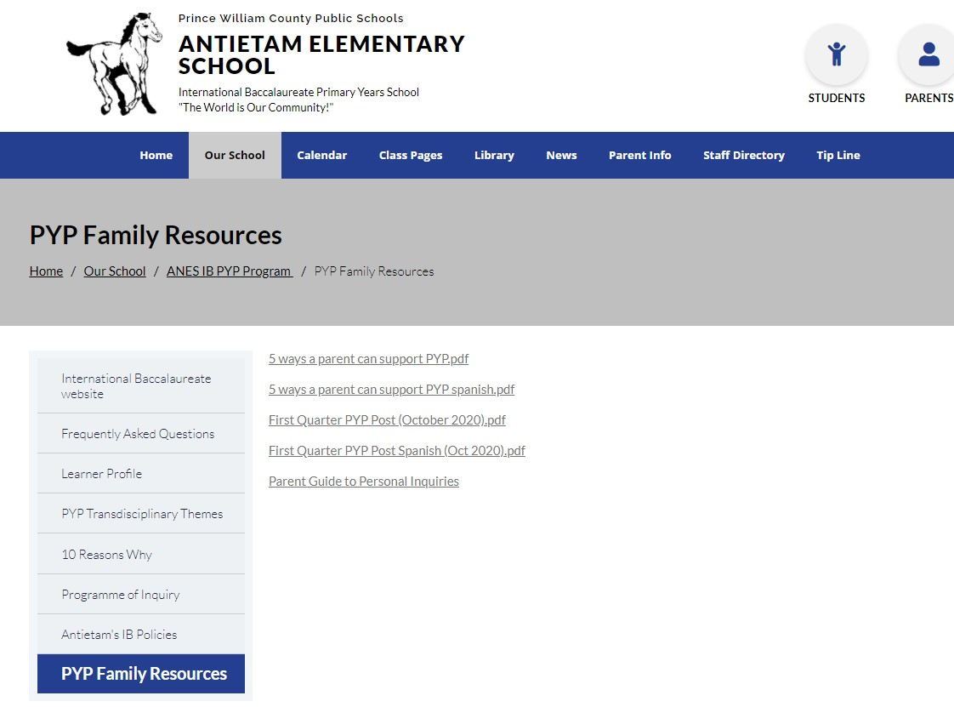
More Information Can Be Found on Our Website:
https://antietames.pwcs.edu/our_school/anes__ib_pyp_program_
For questions, please email:
Melissa Bloomrose, ANES PYP Coordinator
bloomrma@pwcs.edu

