Slide 1
The International Baccalaureate Primary Years Programme at Antietam Elementary School
Family Information Session
January 19, 2021
Via Zoom Breakout Room

Slide 2
Antietam’s Feeder Schools
Your child(ren) would transfer to Antietam for the IB program if they attend one of the following elementary schools:
Belmont Potomac View
Covington-Harper River Oaks
Featherstone Rockledge
Fitzgerald Springwoods
Kilby Swans Creek
Lake Ridge Triangle
Leesylvania Vaughn
Marumsco Hills Westridge
Occoquan Williams
Old Bridge
Students who attend Antietam as their base (neighborhood) school are automatically part of the IB program.
If your child(ren) attend a school not listed above, they would transfer to one of the other PYP schools: Ellis, Mullen, Rosa Parks, or Buckland Mills. You need to leave this breakout session and return to the general meeting.

Slide 3
Antietam as a PWCS School
Antietam Elementary opened in 1990. It has gone through some renovations and expansions in the past few years.
As of September 2020, we had 777 students and 87 staff members.
In the past 20 years, we have been a School of Excellence for 16 of those years, including the last two years, 2018-2019 and 2019-2020.

Slide 4
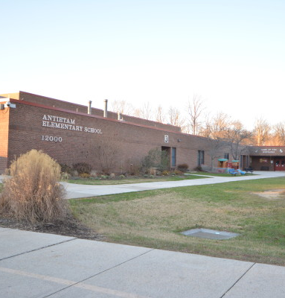
Antietam as an IB School
Antietam Elementary became an IB candidate school in 2013. We were authorized as an IB School in April 2017. We are currently undergoing our first evaluation after authorization, and IB representatives will visit us in November 2021.

Slide 5
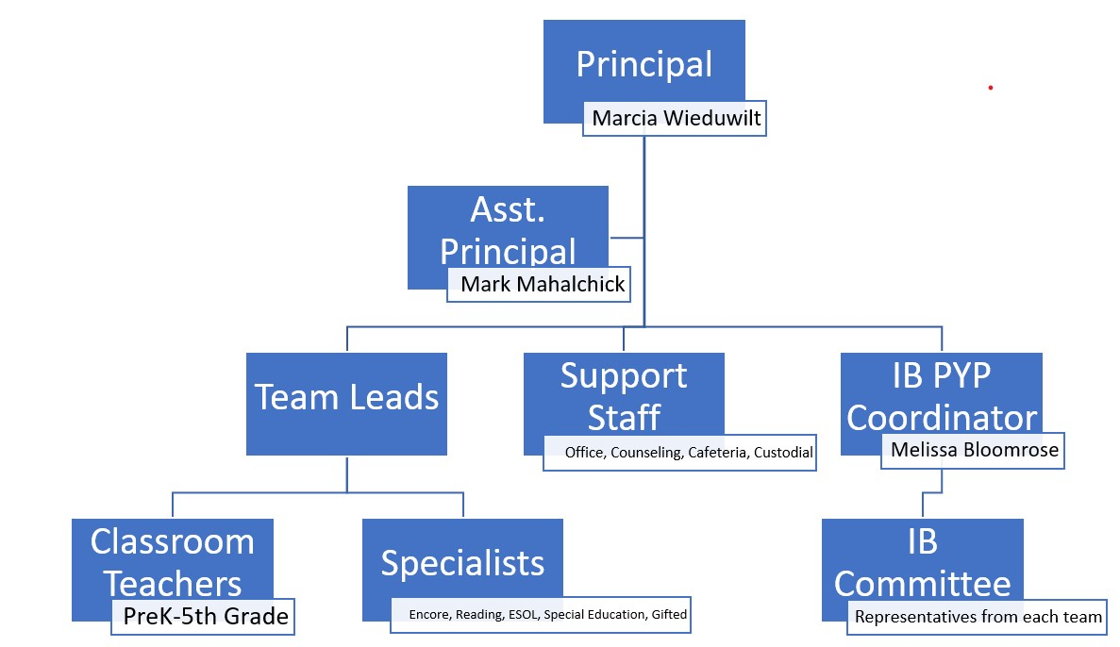
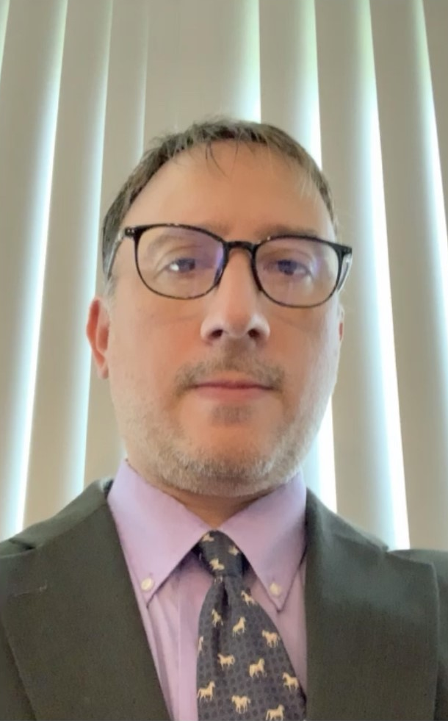
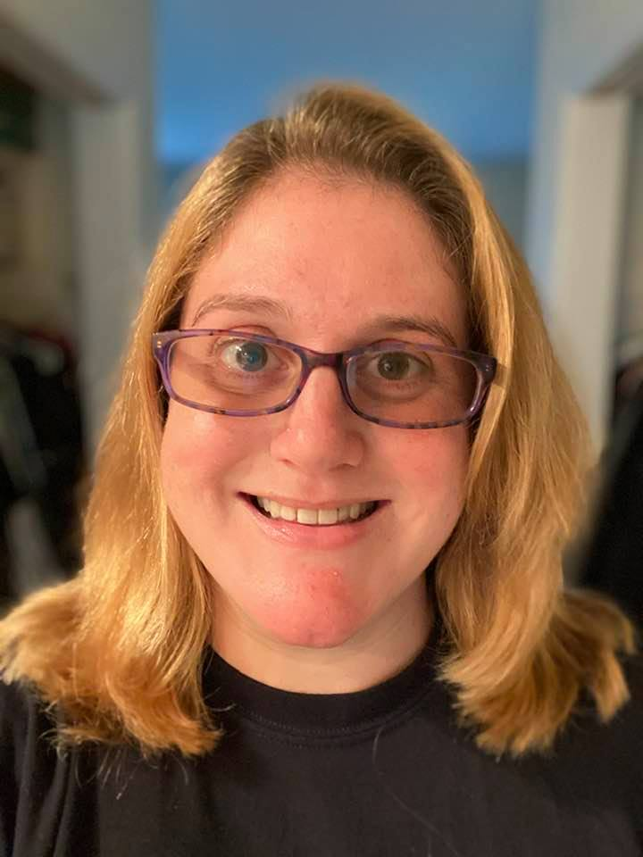
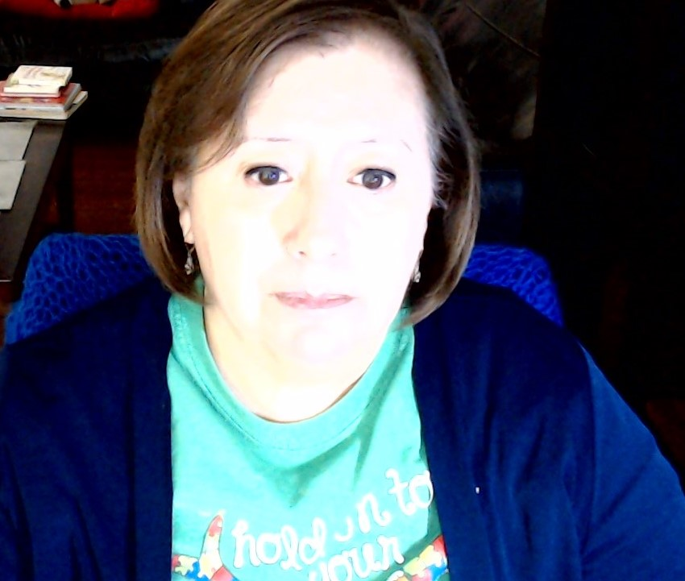
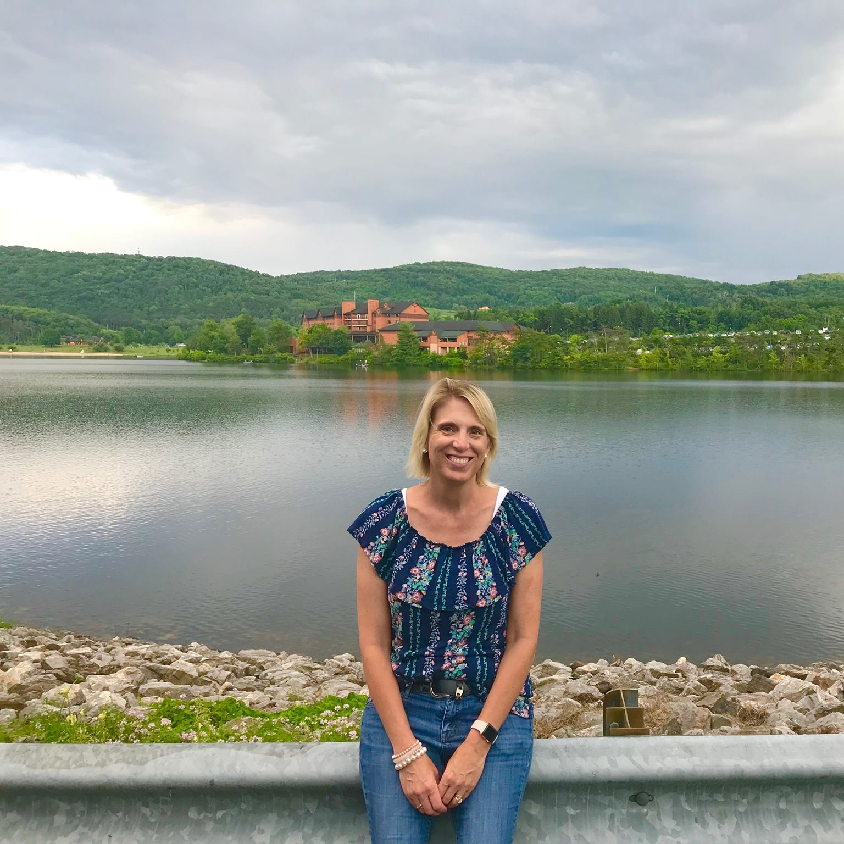
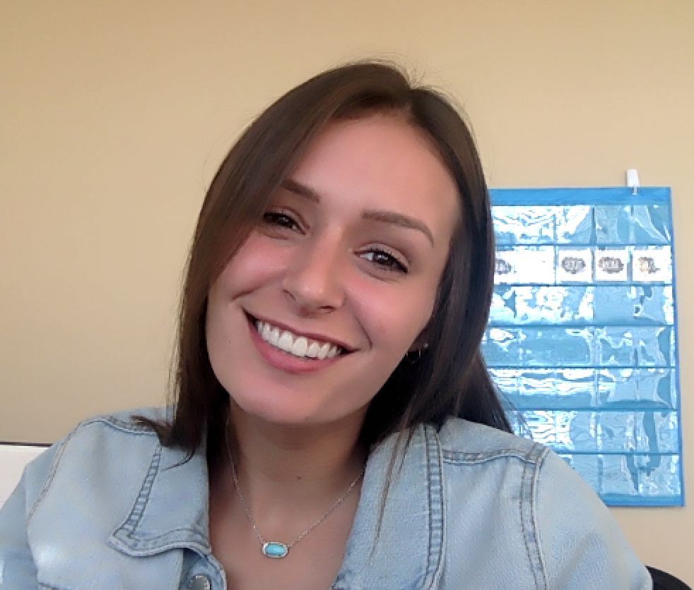
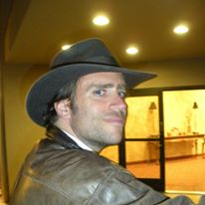
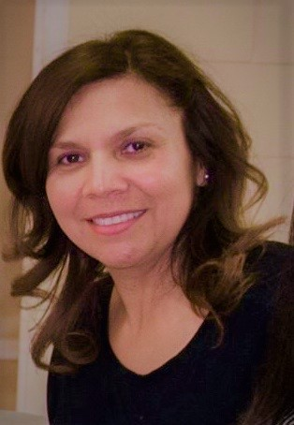
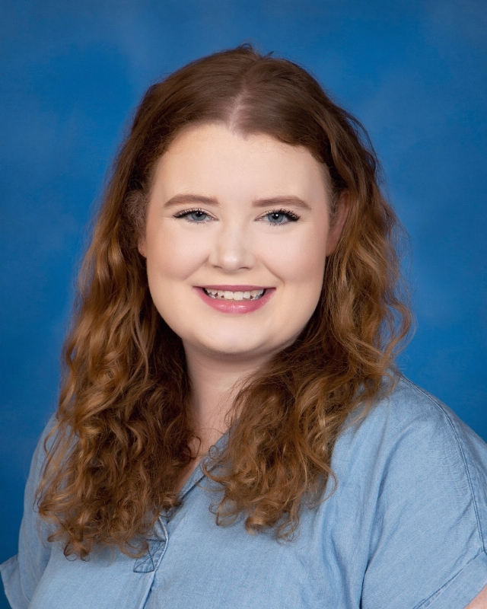
Who’s Who

Slide 6
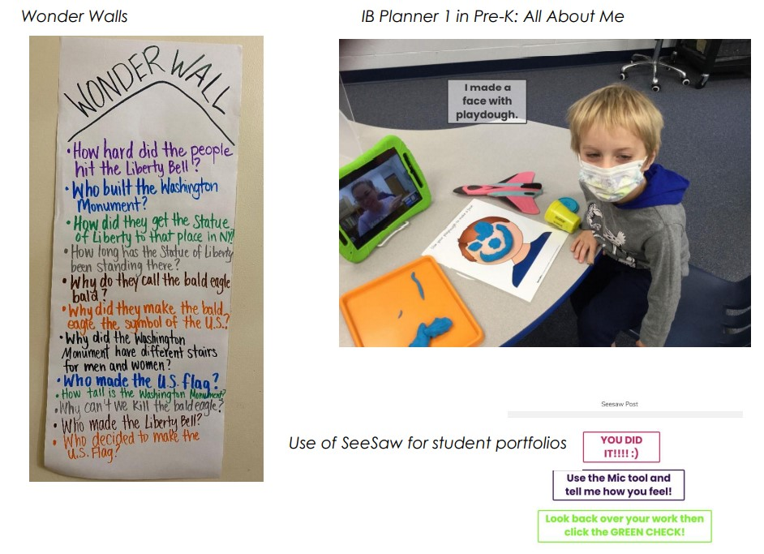
What Does IB PYP Look Like at Antietam?

Slide 7
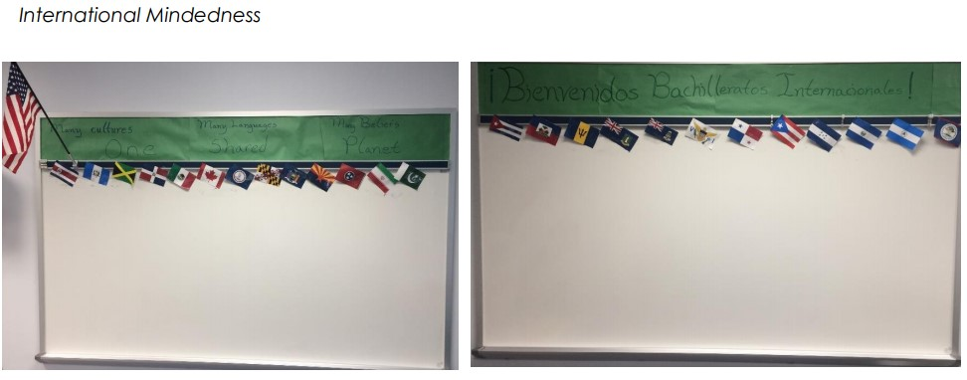
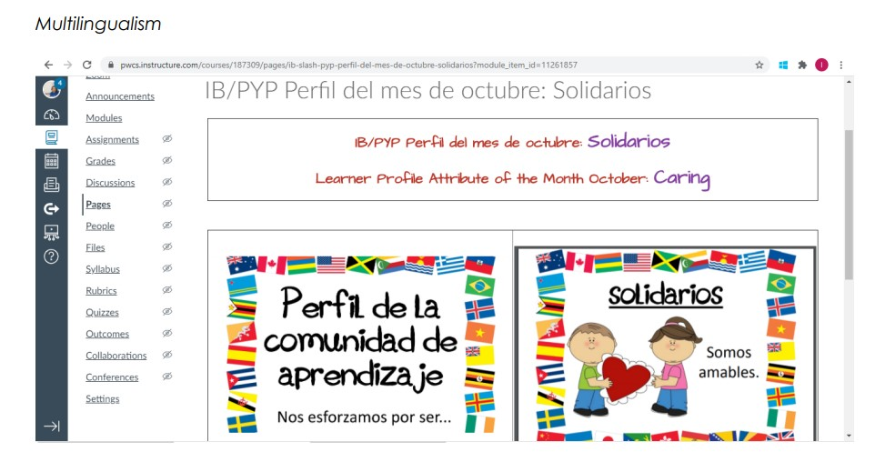

Slide 8
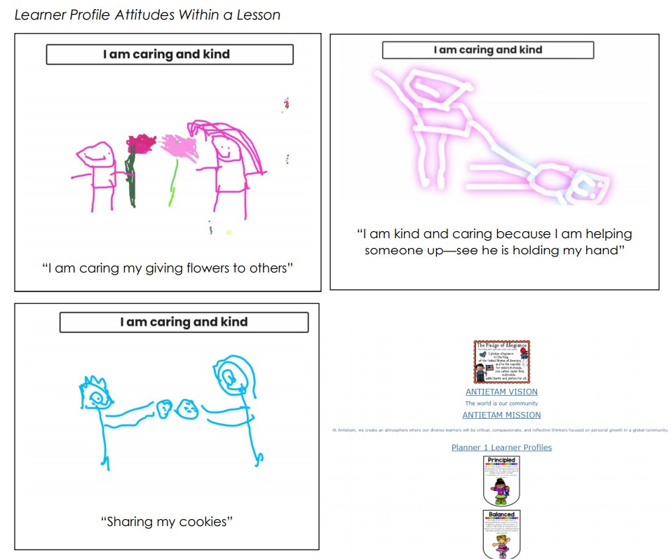
Learner Profile Attributes within Lessons

Slide 9
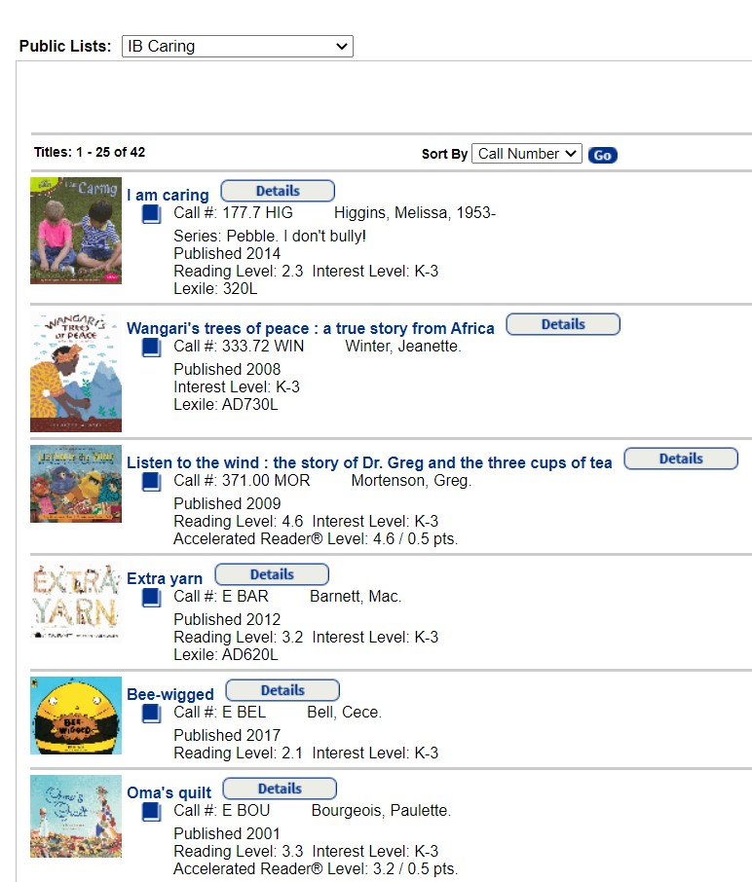
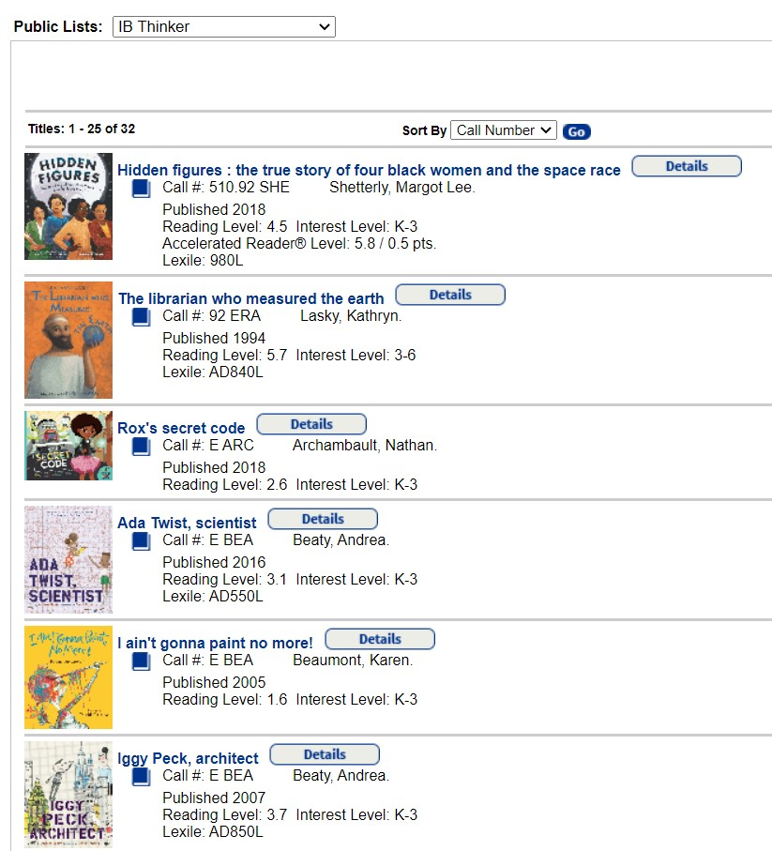
Our library staff has compiled lists of books for each of the Learner Profile attributes!

Slide 10
Spotlight:
Antietam Elementary is fortunate to have a subscription to Seesaw, paid for by our PTA.
5th Grade Teacher Ms. Ashley Brucker will share how her grade level utilizes Seesaw for student portfolios and family communication!

Slide 12
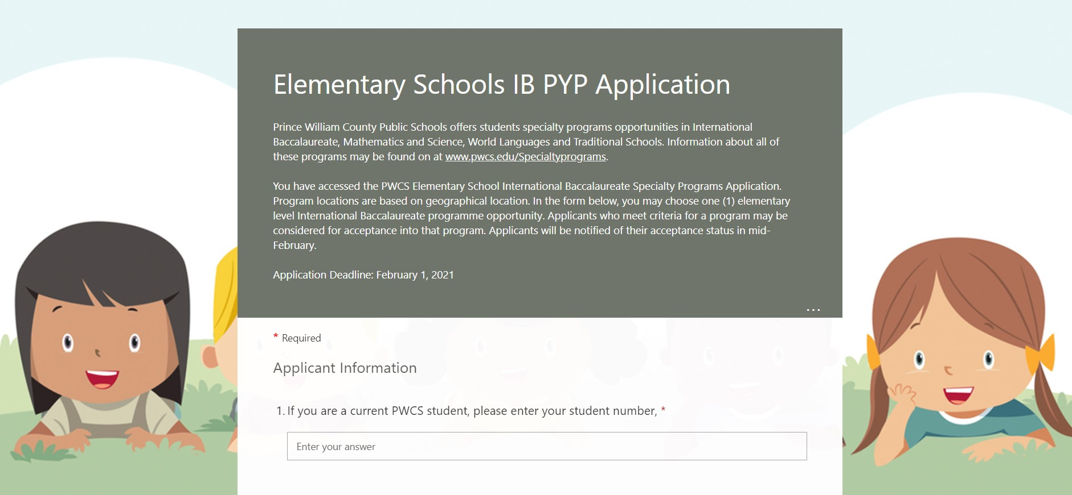
Transfer Application
During this current 2020-2021 school year, we have 20 transfer students for the IB program!
We would love to add more transfer students to our Antietam school community!
Transfer Application:
Elementary Schools IB PYP Application (office.com)
Due February 1, 2021

Slide 13
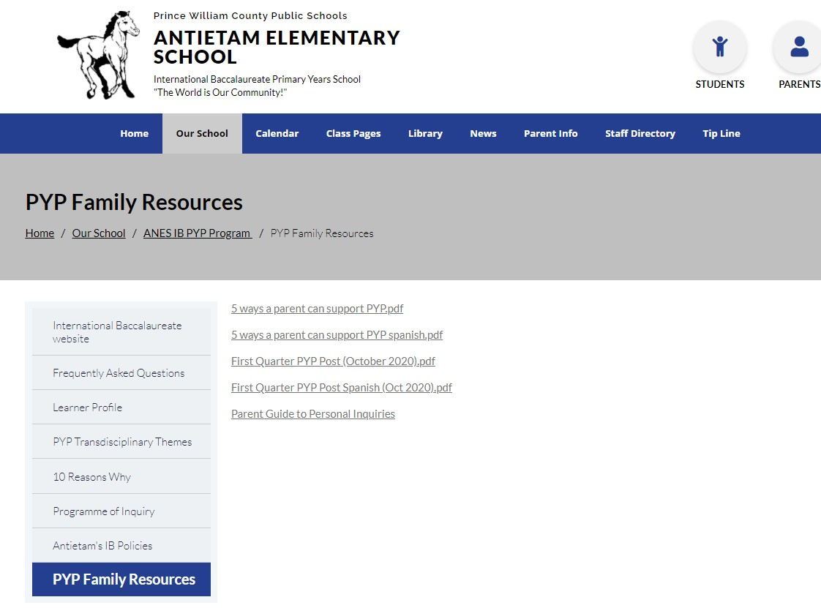
More Information Can Be Found on Our Website:
https://antietames.pwcs.edu/our_school/anes__ib_pyp_program_
For questions, please email:
Melissa Bloomrose, ANES PYP Coordinator
bloomrma@pwcs.edu

